Slide 1



Automatic Detection challenge on Age-related Macular degeneration
Chia-Yen Lee
Chih-Chung,HSU
CHENG-JHONG,LIN
CHANG,CHUNG-HSUAN
HUNG,YEH
Chih-Yu,JIAN
Member
ISBI2020

Slide 2
Task1

Slide 3
Model
Data Augmentation
(rotation, contrast transform, and random crop) & Normalize
Model training
(Model : EfficientNet)
Predict
(Tencrop ensemble)

Slide 4
Task2

Slide 5
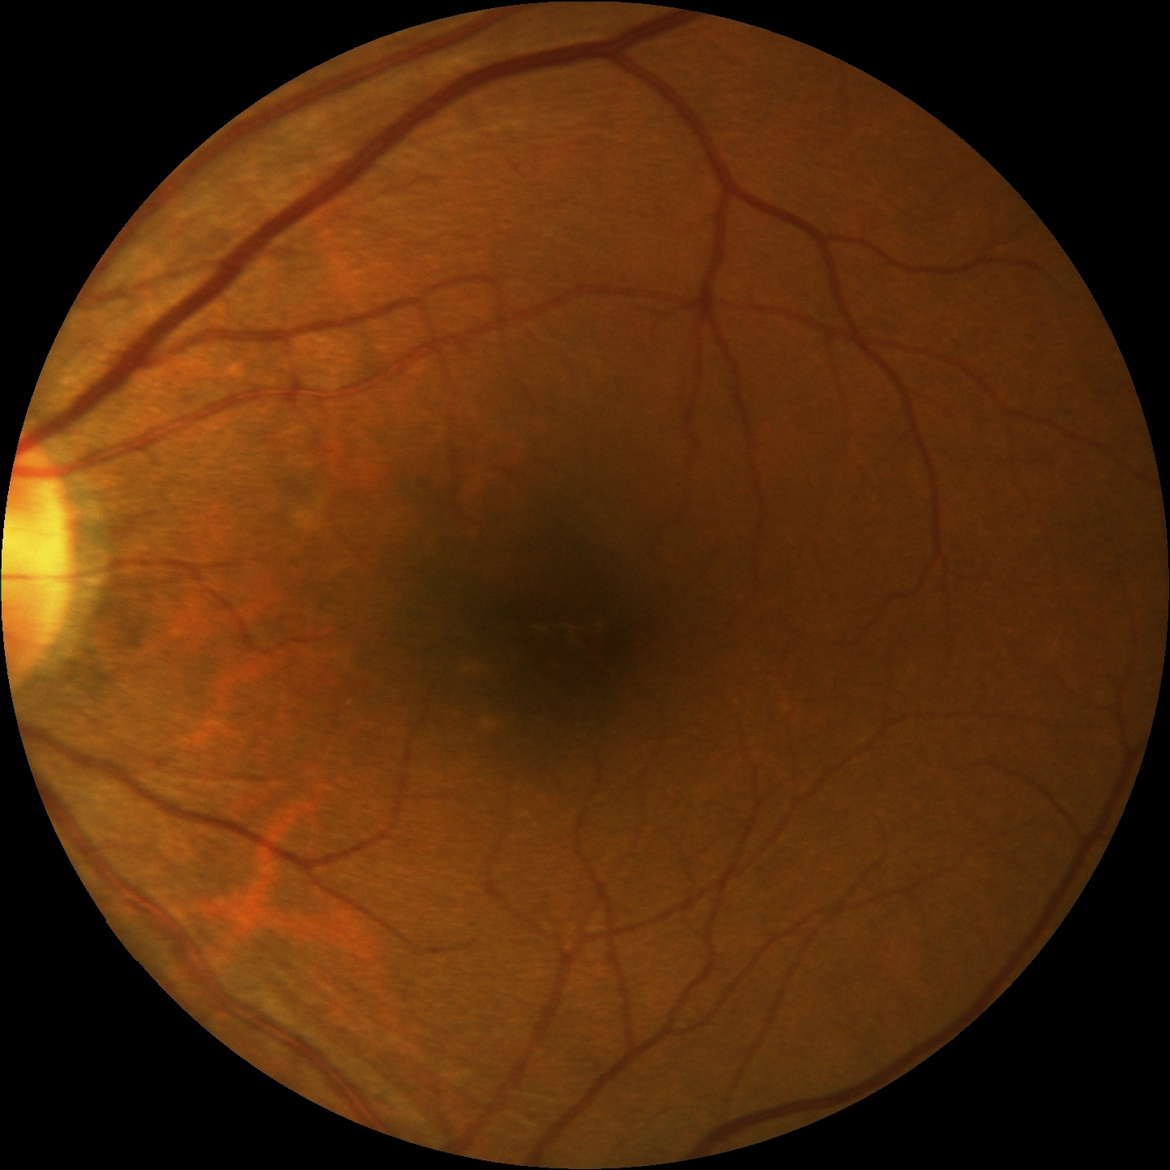
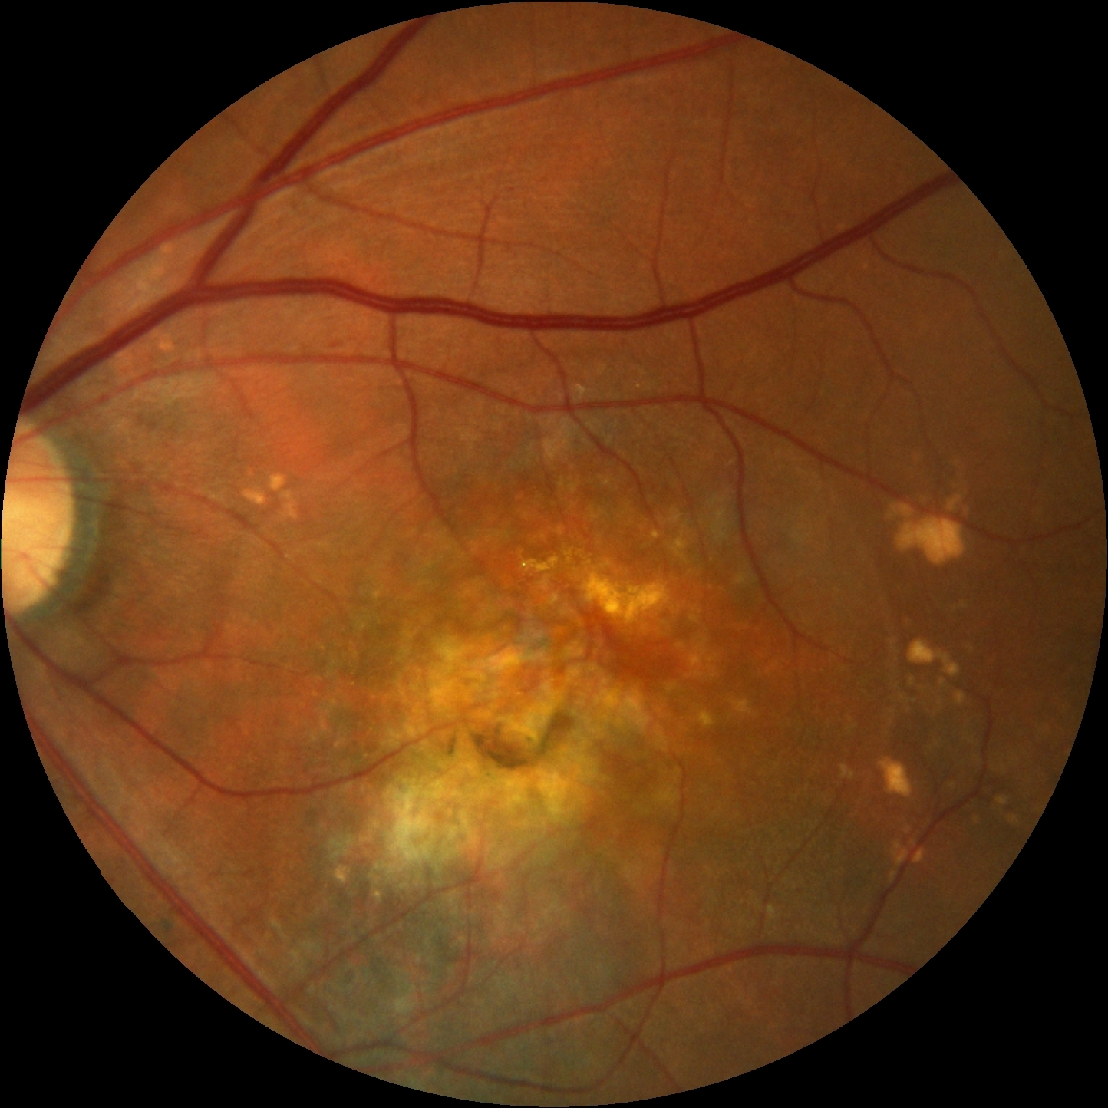
Category OD is complete or not

Slide 6
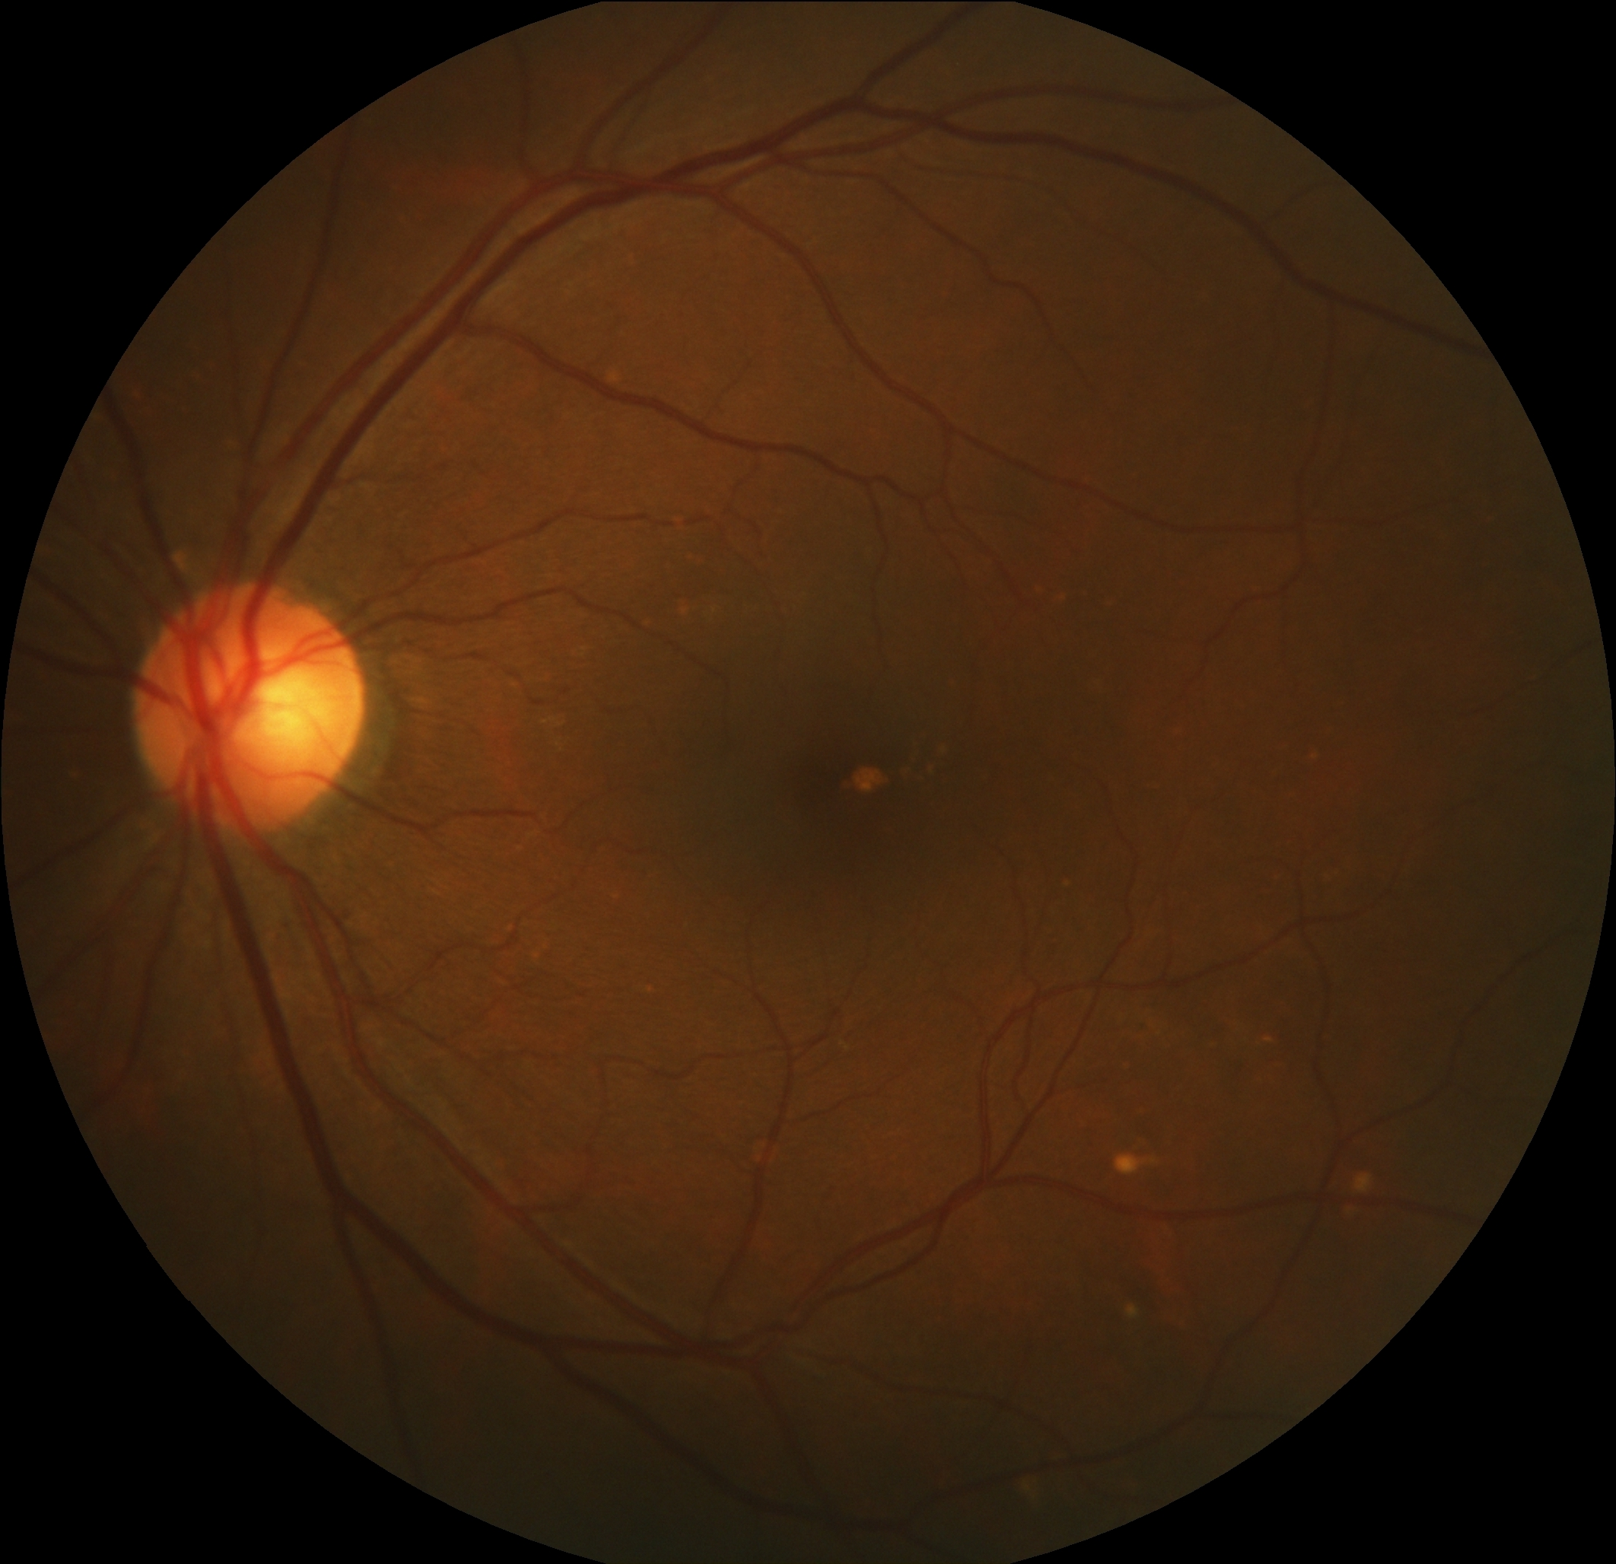
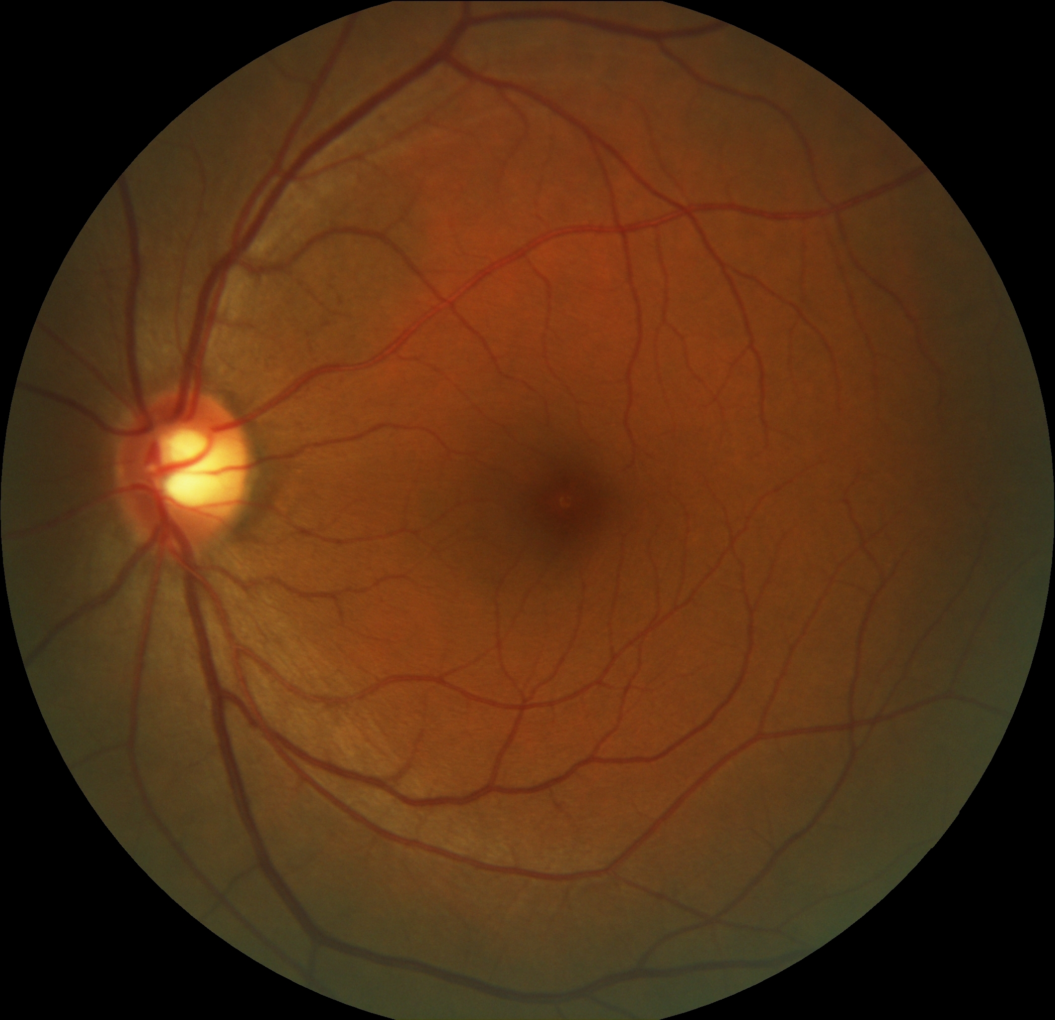
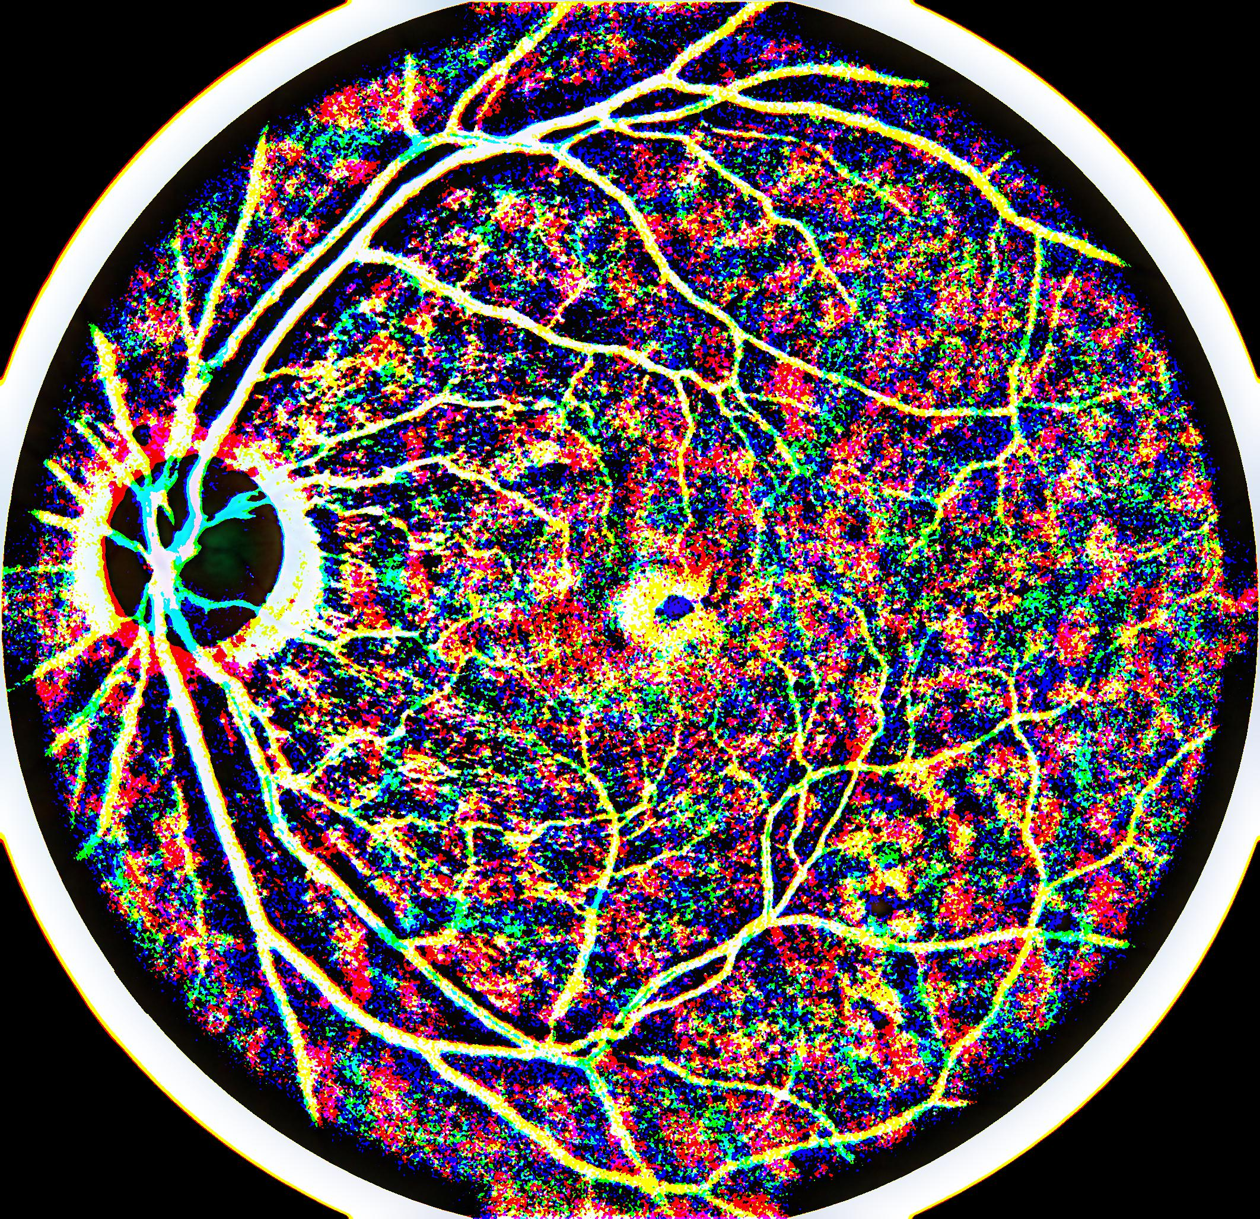
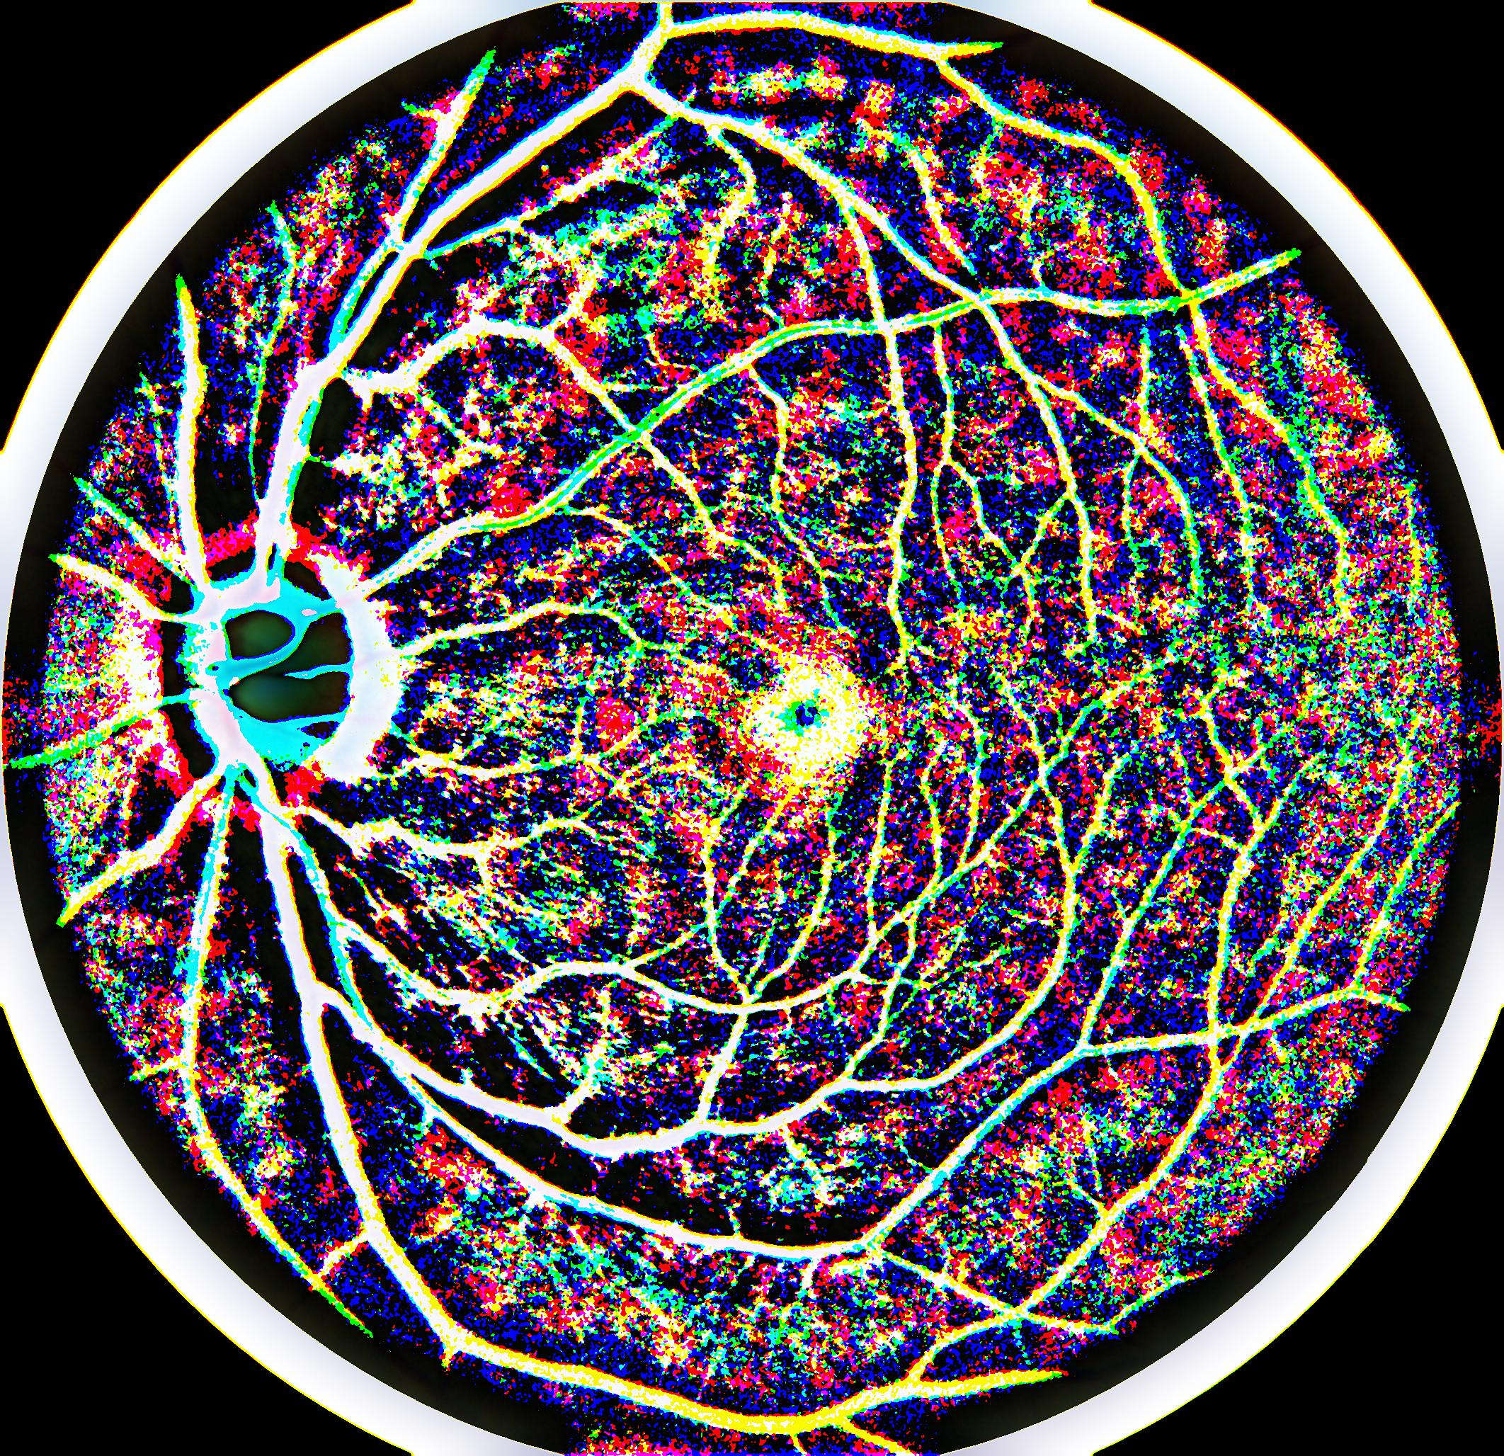
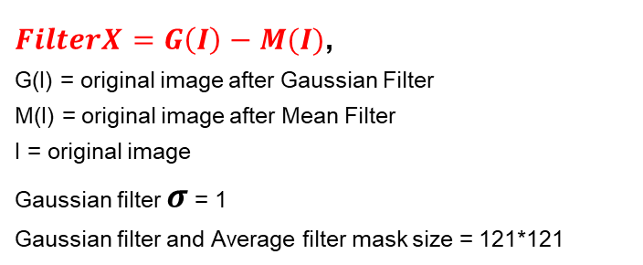
Local Filter(D.O.G concept)
$FilterX=G\left(I\right)−M(I)$,
G(I) = original image after Gaussian Filter
M(I) = original image after Mean Filter
I = original image
Gaussian filter $σ$ = 1
Gaussian filter and Average filter mask size = 121*121

Slide 7
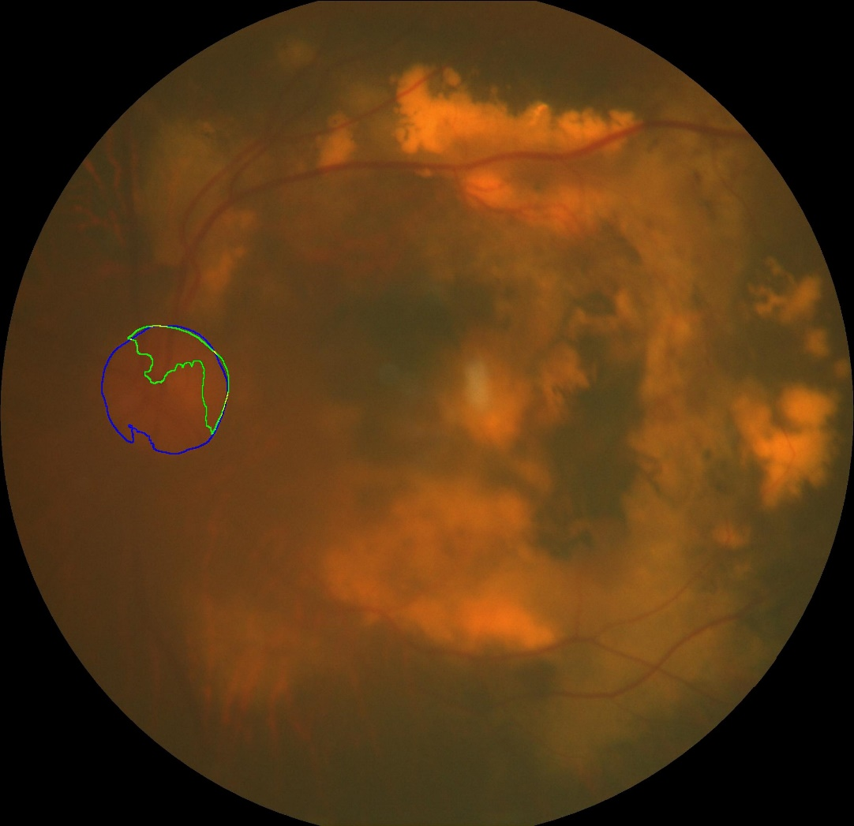
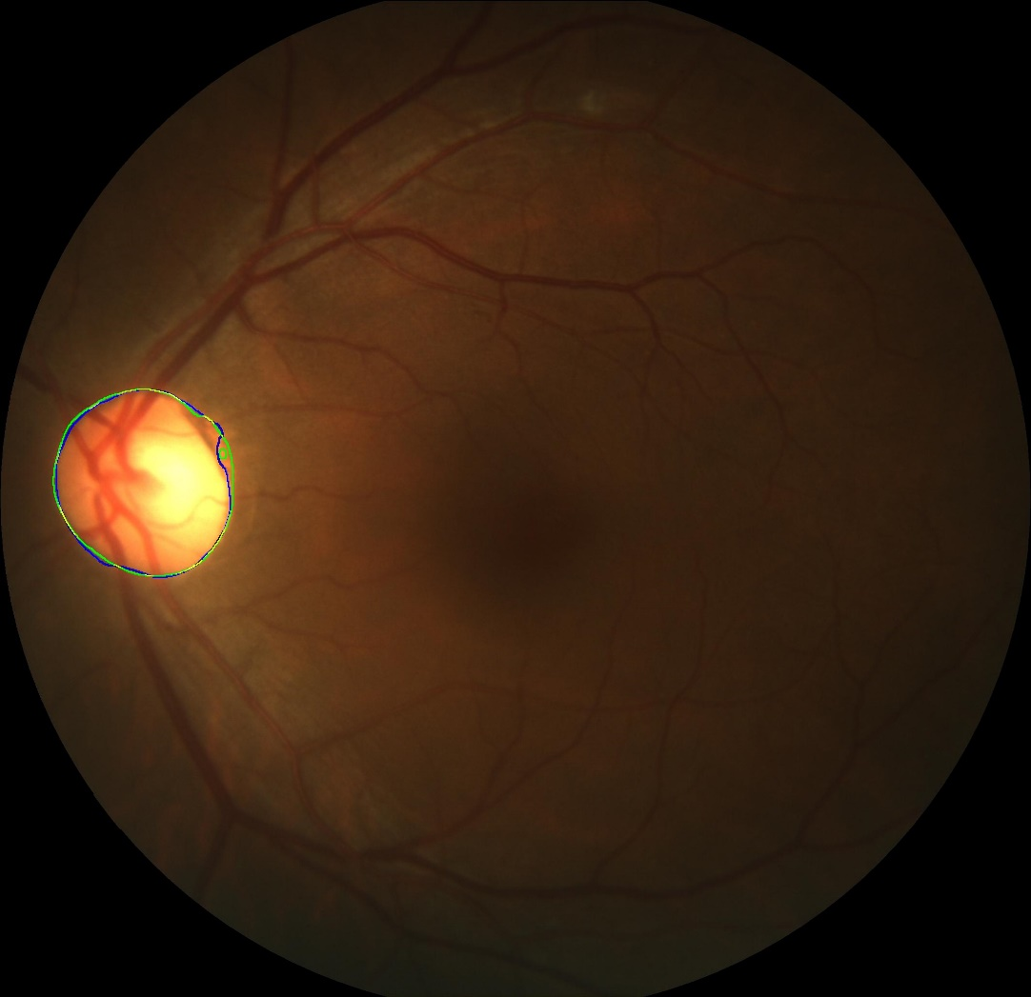
New image compare with original segment
Original image segment
New image segment
Model : U-Net

Slide 8
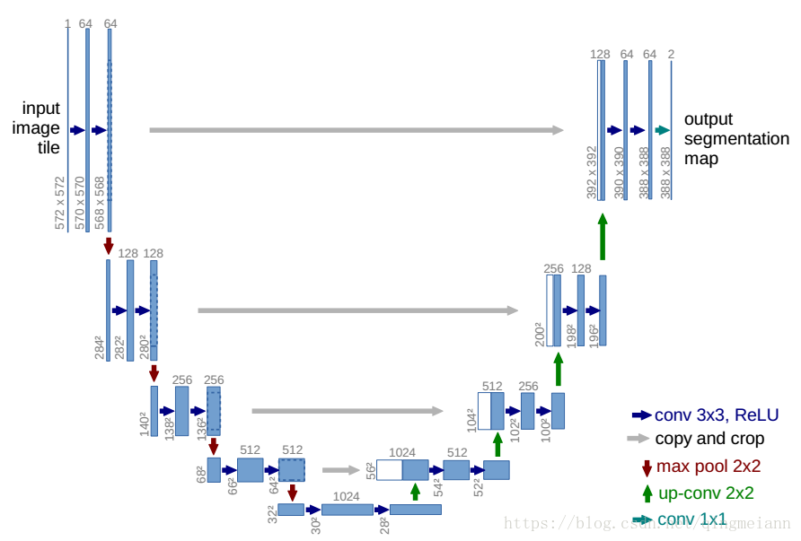
Model

Slide 9
Task3

Slide 10

Segmentation
Ground truth dilate:
Model :
U-Net (original image)
Attention U-Net (original image)
U-Net (ImageX)
Dilate structuring element radius = 80,disk

Slide 11
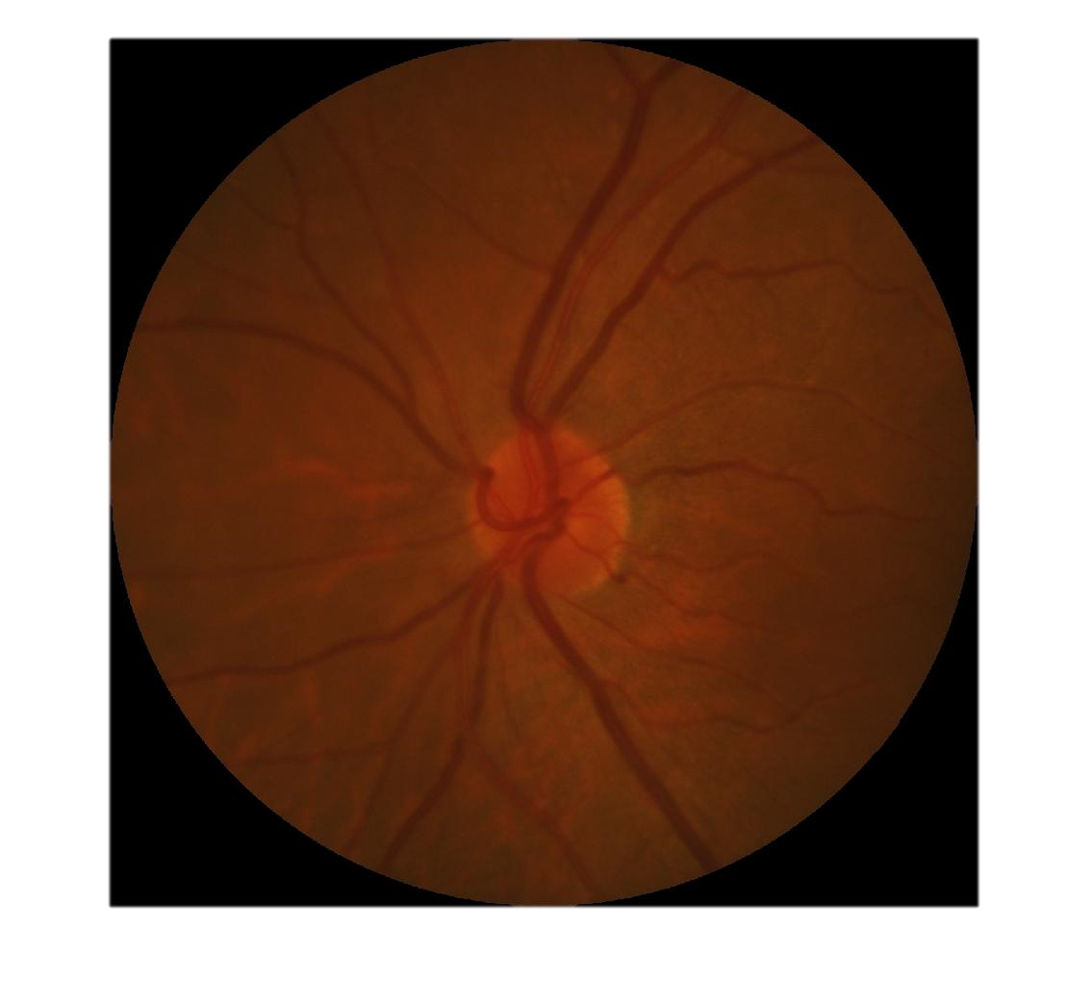
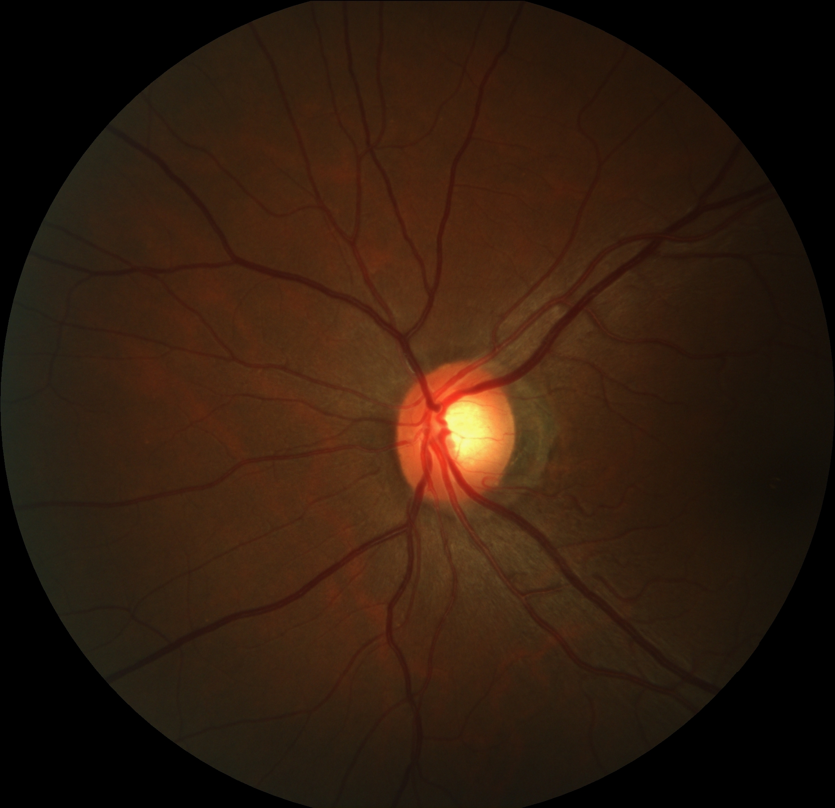
Remove predict point if OD at image center

Slide 12
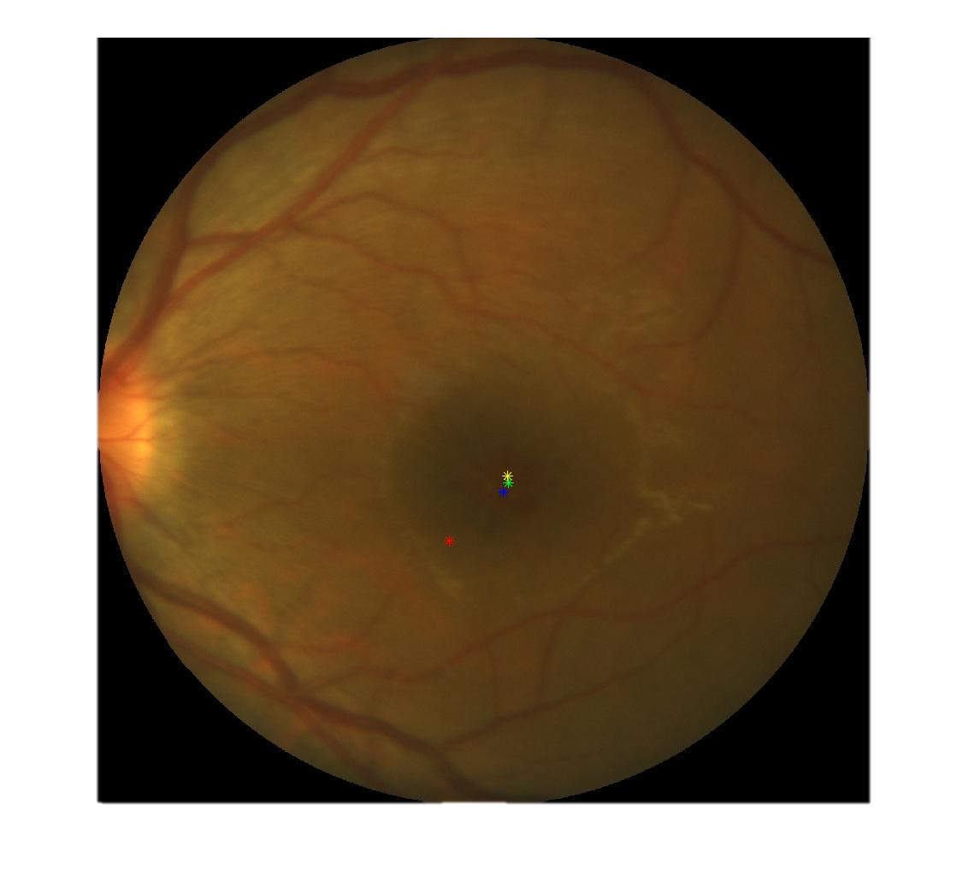
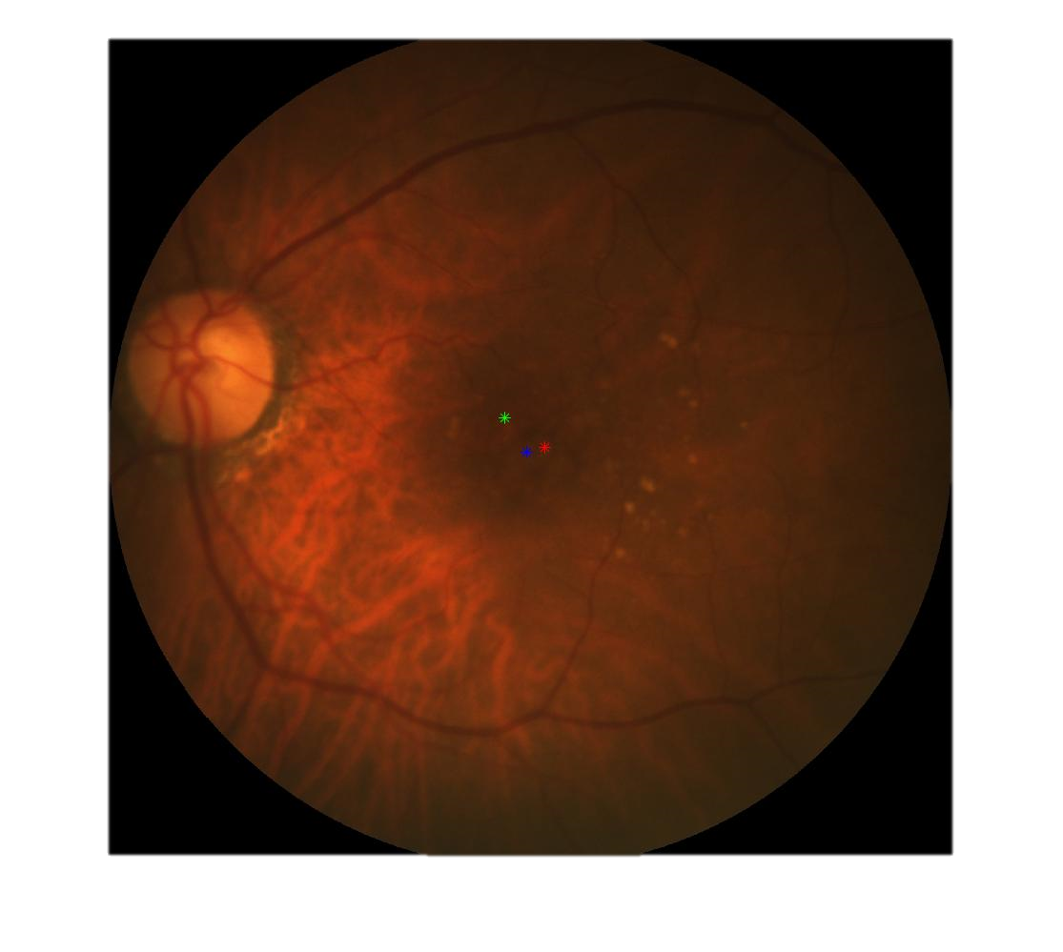
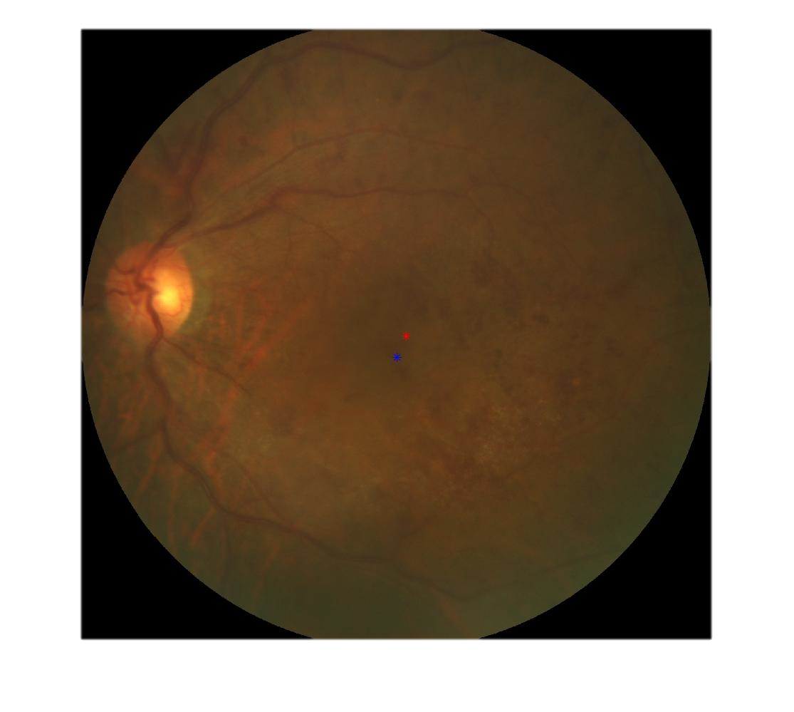
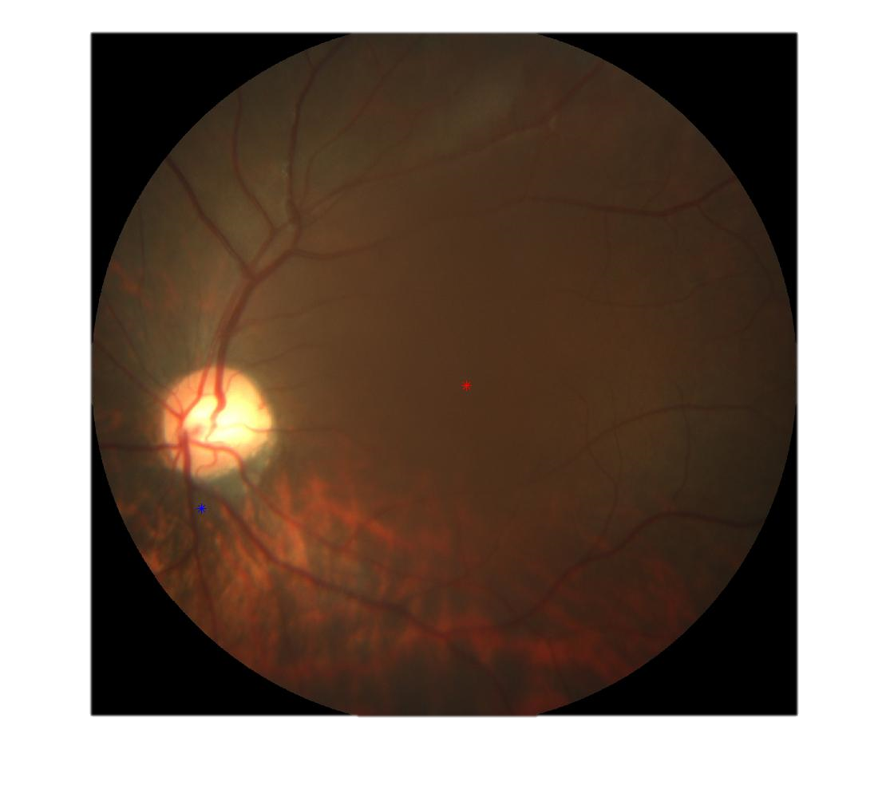
Models fusion
Green : U-Net (original image)
Red : ResNet (original image)
Blue : Attention U-Net (original image)
Yellow : U-Net (imageX)

Slide 13
Task4

Slide 14

謝謝聆聽
軟體D組 D2
U0521125 葉鴻
U0521131 許詠益

